Slide 1

Quantitative Emotion Prediction of Texts in Valence and Arousal Space from Microblog Data
Student: Shi Jinping (師晉平)
Advisor: Prof. Yi-Shin Chen
Institute of Information Systems and Applications,
National Tsing Hua University
Notes:
Good afternoon
Thank you for attending my oral defense
My oral defense topic is Quantified Emotion Prediction of Texts in Valence and Arousal Space from Microblog Data

Slide 2
Outline
Introduction
Related Work
Objective
Methodology
Experiment and Evaluation
Conclusions
Notes:
I will present my research by the following outline

Slide 3
Outline
Introduction
Related Work
Objective
Methodology
Experiment and Evaluation
Conclusions
Notes:
I will present my research by the following outline

Slide 4






Introduction
?
Basically, there are two different types of text emotion detection
Determinative Classification based on discrete emotions
Numerical Method based on continuous emotion
Notes:
Nowadays people like to express their feelings on social media, like Facebook and twitter. And we would like to detect the emotion they express through their posts.
But how to detect the emotion of text?
Basically, there are two different ways of text emotion detection

Slide 5
Related Work
Determinative Classification
{negative, neutral, positive} or {Anger, Disgust, Fear, Joy, Sadness, Surprise}
Shiyang W. etc., Emotion Classification in Microblog Texts Using Class Sequential Rules, 2014
Maria etc., Sentiment Polarity Detection in Spanish Reviews Combining Supervised and Unsupervised approaches, 2013
Mass etc., Learning word vectors for sentiment analysis, 2011
Yoon, Convolutional Neural Networks for Sentence Classification, 2014
Naïve Bayes
Support Vector Machine (SVM)
Random Forest
Convolutional Neural Networks (CNN)
Recurrent Neural Network (RNN)
Classifies text into a discrete emotion candidates set
Generally one emotion or finite emotions are detected
Notes:
The first one is determinative classification. By using this method, we can classify a text into negative or positive, or more specifically, into anger or joy.
This method is very popular among researchers. Many work have been done by using various classification methods, like naïve Bayes, SVM, and recently, many researchers have applied CNN and RNN on text emotion classification.
Basically, no matter what methods are used, determinative classification mainly classifies text into a discrete emotion candidates set. So generally, only one emotion or finite emotions are detected.

Slide 6
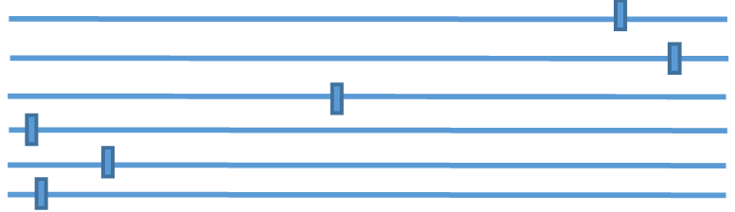

Related Work
Surprise
Joy
Anticipation
Anger
Sadness
Disgust
Thanks for the birthday wishes everyone!!!
Surprise
Joy
Joy
Anticipation
Anger
Sadness
Disgust
Surprise
Joy
Anticipation
Anger
Sadness
Disgust
[Argueta, Carlos etc., 2015]
Notes:
To employ the supervised approach, we need to label the data.
We could let annotators to label the given text. We can choose the answer that the majority have chosen as the final answer.

Slide 7
Related Work
Surprise
Anger
0.01
Joy
Anticipation
Anger
Disgust
0.00
Sadness
Disgust
Thanks for the birthday wishes everyone!!!
Surprise
Sadness
0.01
Joy
Anticipation
Anger
Sadness
Joy
0.50
Disgust
Surprise
Anticipation
0.10
Joy
Anticipation
Anger
Sadness
Surprise
0.38
Disgust
Not easy for laymen (annotators) to conceptualize affects
Inter-relationships among emotions are not clear
What if Anger = Disgust = Sadness = Happy = Fear = Surprise = 1/6 ?
Notes:
To employ the supervised approach, we need to label the data.
We could let annotators to label the given text. We can choose the answer that the majority have chosen as the final answer.

Slide 8
Related Work
Numerical Method
(based on VA Emotion Model)
Valence (x-axis):
the pleasantness of a stimulus, also referring to as sentiment
Arousal (y-axis):
intensity of emotion provoked by a stimulus
Valence and arousal space (VA-space)
It is numerical and continuous, thus regression approaches are generally used
It is natural for annotators to rate
[Russell James A. A circumplex model of affect.Journal of Personality and Social Psychology, pages 1161–1178, 1980]
Notes:
So some researchers tend to use other methods to extract emotions from text. They define an emotion in a two dimensional continuous space. The first dimension is called valence. It is the pleasantness of a stimulus and also called sentiment. The other dimension is arousal. We can treat it as the intensity of emotion provoked by a stimulus.
So this space is also called VA space and this emotion model is also called VA emotion model. We can see that it is numerical and continuous, therefore, we often use regression approaches to extract text emotions.
(GIVE ME FINE) And besides, it is natural for annotators to rate because compared to determinative classification, this method asks users to evaluate current emotional status instead of understanding the emotion concept.

Slide 9
Related Work
Linear and Non-linear Regression
Daniel. etc., Modelling Valence and Arousal in Facebook Posts, 2016
Georgios Paltoglou and Michael Thelwall. Seeing stars of valence and arousal in blog posts. IEEE Transactions on Affective Computing, 4(1):116–123, 2013
Graph Based
Jin W. etc., Community-Based Weighted Graph Model for Valence-Arousal Prediction of Affective Words, 2016
Probabilistic Model
Ju-Chiang Wang, etc. Modeling the affective content of music with a gaussian mixture model. IEEE Transactions on Affective Computing, 6(1):56–68, 2015
Sicheng Zhao, etc. Predicting continuous probability distribution of image emotions in valence-arousal space. pages 879–882. ACM, 2015
Notes:
Many work have been done based on this VA emotion model.
Some researchers used linear or non-linear regression to predict the VA values of texts
Some researchers applied graph theory to infer unseen text emotion in VA space.
in addition, VA emotion model is also used in other fields. Some researchers proposed probabilistic model to get the distribution of emotion of music or images.

Slide 10
Related Work
Stop it! It’s not funny!
Arousal
Arousal
Expected location
Valence
Valence
causes bias
words lack VA values
Jin W. etc., Community-Based Weighted Graph Model for Valence-Arousal Prediction of Affective Words, 2016
Notes:
To detect emotion in VA space, we need to label data as well.
We could rate the words of a sentence and then take the average as the VA values of the whole sentence.
However, it may cause bias because it does not consider the context. And in addition, some words may lack VA values.

Slide 11
Related Work
Arousal
Arousal
Stop it!
It’s not funny!
Rating
Average
Valence
Valence
VA ratings
Only provides the location of the text in VA space
How accurate the location is?
Variance ratings
Daniel. etc., Modelling Valence and Arousal in Facebook Posts, 2016
Notes:
Alternatively, we can rate the whole sentence rather than words.
But, it only provides the location of the text in VA space. And as we can see, because different annotators may have different feelings to the same text, even for the same emotion, they may have different ratings. So the VA ratings may be in big variance.

Slide 12
Objectives
Our Method – EmoPredictor: A Probabilistic Model
Integrates determinative classification into VA emotion model
Instead of obtaining a specific emotion or exact values in VA-space, for a given statement,
we provide the emotion distribution in VA space
Thanks for the birthday wishes everyone!!!
Arousal
Valence
Notes:
So, in our research, we propose a probabilistic model, called EmoPredictor, to extract the emotions from text
This model integrates determinative classification into VA emotion model, which avoids the drawbacks of both numerical emotion extraction and determinative classification.
We don’t assign a specific emotion to the text or provide exact values in VA space, instead, for a given statement, we provide the emotion distribution in VA space.

Slide 13
Outline
Introduction
Related Work
Objective
Methodology
Overview
Framework
EmoPredictor Modeling
Experiment
Conclusion
Notes:
Next, I will present the methodology of our approach.

Slide 14
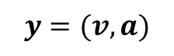
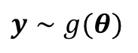
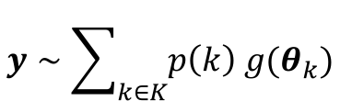
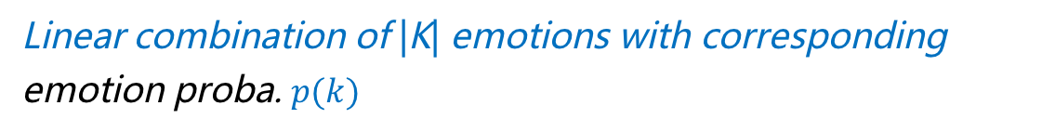
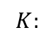
Methodology – Assumptions
Different users have different quantified perceptions toward the same emotion, but the perceptions converge to a certain distribution.
For a single emotion of a text :
$$y=(v,a)$$
For the emotion distribution of a text:
$$y∼g(θ)$$
The text emotion consists of multi-emotions rather than a single emotion
$$y∼\sum_{k∈K}{p\left(k\right) g(θ_{k})}$$
Mixture Model
$$K:$$
possible emotion set
Linear combination of |K| emotions with corresponding emotion proba. $p(k)$
Notes:
Let’s first look at the assumptions.
Actually, most of the work I introduced just now follows or implies the following assumption. The first one…
This just corresponds to the previous example that we taking average of the weight of each emotion and we choose the emotion that the majority chose
So we first denote valence values as bold v and arousal values as bold a. Let y = (v,a), representing the emotion of texts. Then we can use g(\theta) to represent the emotion distribution. \theta is the parameters of this distribution.
Second, the text emotion consists of multi-emotions rather than a single emotion. Suppose the text emotion contains possible K emotions, we can simply combine them linearly with p(k) as each emotion’s weight.
So the text emotion distribution, we can treat it as the linear combination of K emotions with corresponding emotion probability p(k)
This is also called Mixture Model.

Slide 15
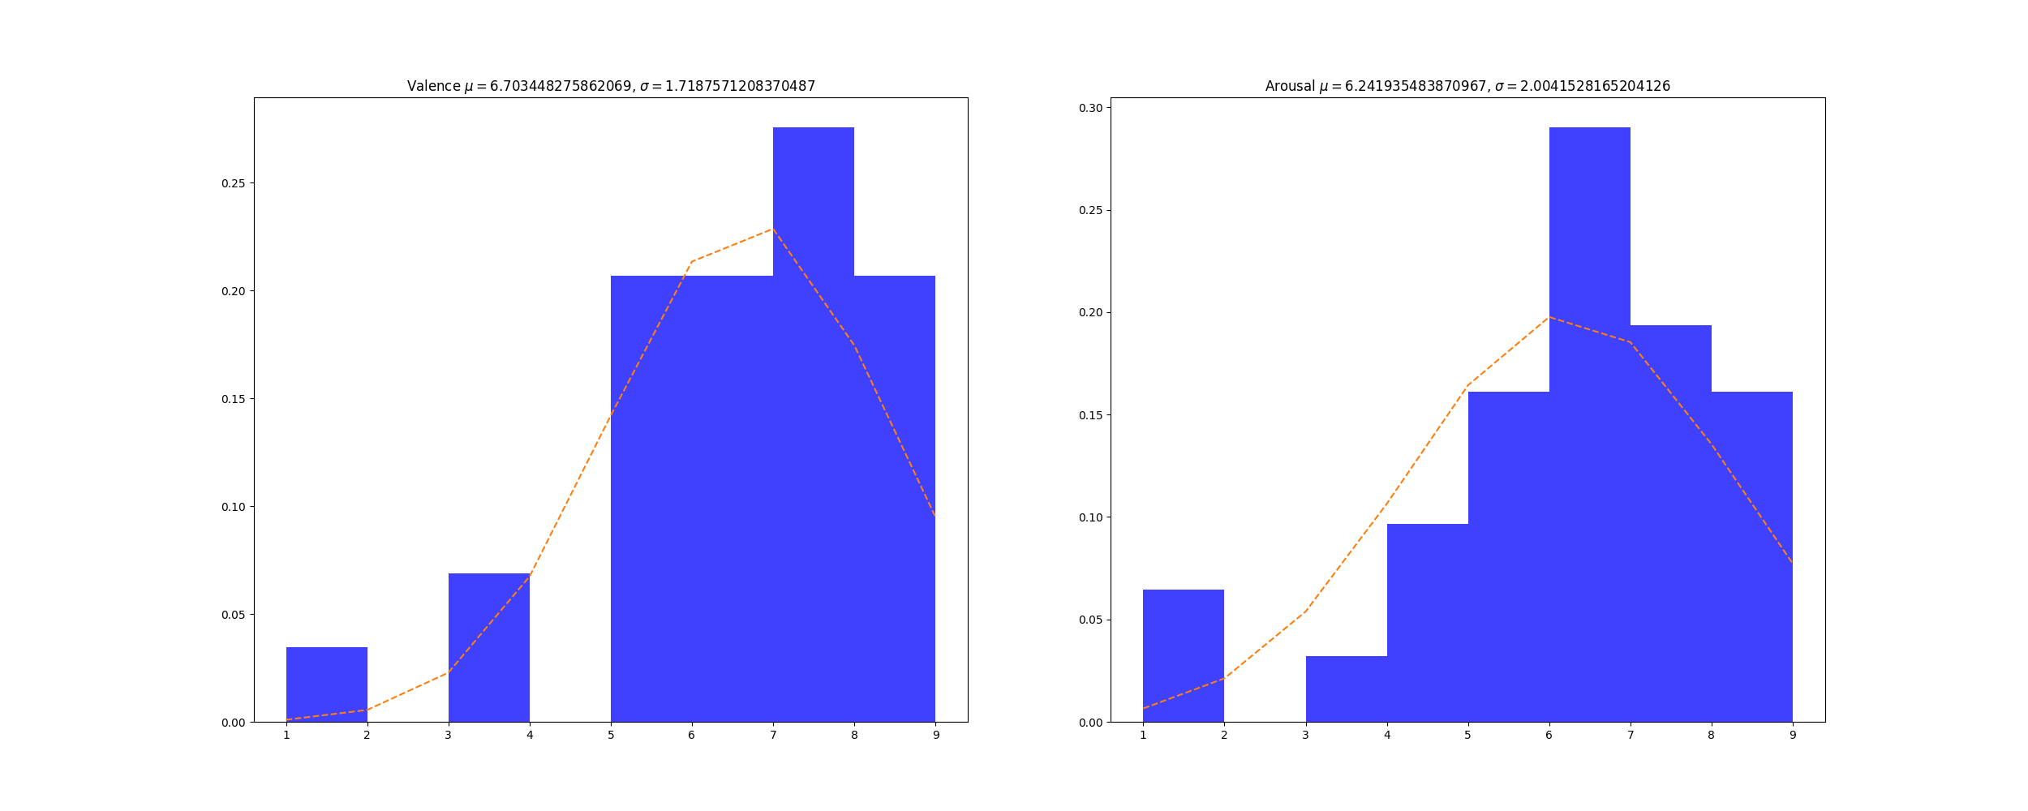
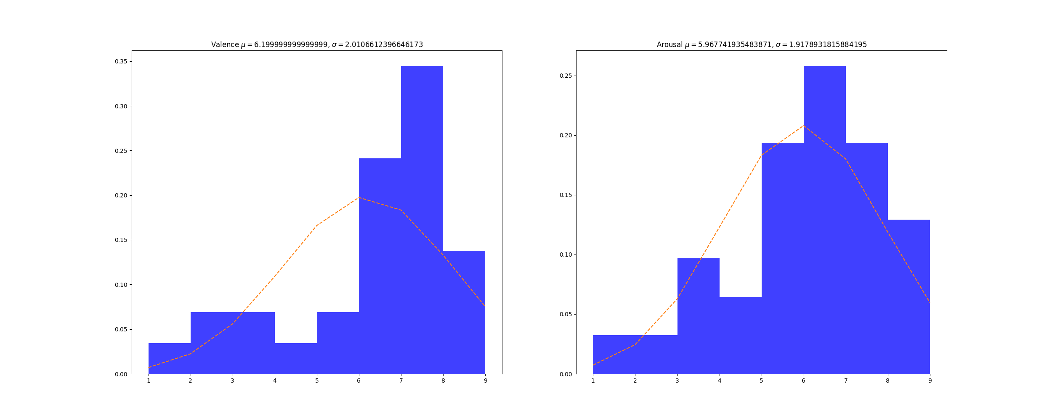
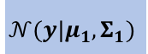
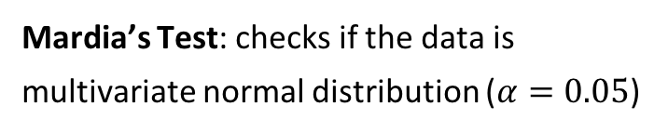
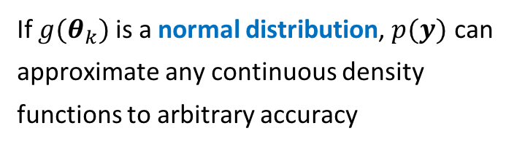
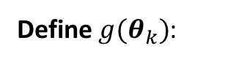
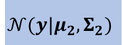
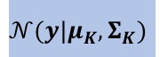
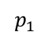
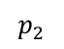
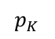
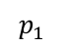
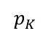
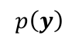
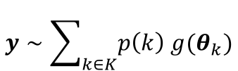
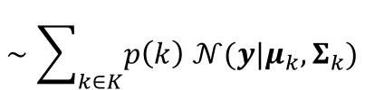
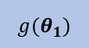
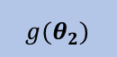
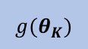
Methodology – Overview
Emo 1
Emo 2
…
Emo K
$$y∼\sum_{k∈K}{p\left(k\right) g(θ_{k})}$$
$$p_{1}$$
$g(θ_{1})$
$$p_{2}$$
$g(θ_{2})$
$$p_{K}$$
$g(θ_{K})$
$$∼\sum_{k∈K}{p\left(k\right) 𝒩(y|μ_{k}, Σ_{k})}$$
$$p_{1}$$
$$𝒩(y|μ_{1}, Σ_{1})$$
$$p_{2}$$
$$𝒩(y|μ_{2}, Σ_{2})$$
$$p_{K}$$
$$𝒩(y|μ_{K}, Σ_{K})$$
Gaussian Mixture Model (GMM)
$$p\left(y\right)$$
Define $g(θ_{k})$:
Advantage:
If $g(θ_{k})$ is a normal distribution, $p(y)$ can approximate any continuous density functions to arbitrary accuracy
Mardia’s Test: checks if the data is multivariate normal distribution ($α=0.05$)
It is adequate to assume VA ratings are bivariate normal distr.
72% of the VA ratings passed Mardia’s Test
Notes:
Suppose for a given statement, we have k possible emotions. For each possible emotion, we define g(\theta) as its distribution with corresponding emotion probability.
Now the first task of our research is that if we want to the get exact values of probability of y, we need to define the clear form of g(\theta)
We observed the data, and found that on each dimension, they are likely can be described by normal distribution. To verify this, we conducted a multivariate normal distribution test on our data. The results show that …
We also found that If $g(θ_{k})$ is a normal distribution, $p(y)$ can approximate any continuous density functions to arbitrary accuracy
So we just define $g\left(θ_{k}\right)$ as normal distribution with parameters \mu and \Sigma, and then combine them, get p(y), that is the emotion distribution

Slide 16
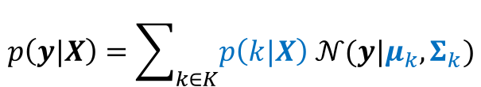
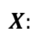
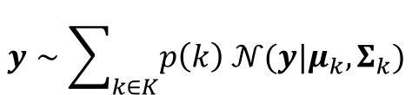
Methodology – Overview
Problem Definition
Given a statement, provide the emotion distribution in VA space
Thanks for the birthday wishes everyone!!!
Arousal
Turns to a parameter estimation problem
Valence
emotion prob. and Gaussian parameters are to be estimated
$$X:$$
features of texts
$$y∼\sum_{k∈K}{p\left(k\right) 𝒩(y|μ_{k}, Σ_{k})}$$
$$p\left(y|X\right)=\sum_{k∈K}{p\left(k|X\right) 𝒩(y|μ_{k}, Σ_{k})}$$
Emotion classifier
VA ratings
Notes:
Now let’s recall our goal of this research. For a given statement, we want to get the emotion distribution in VA space.
We define X as the features of texts. Thus, given X, we can get the clear form of EmoPredictor. This turns to a parameter estimation problem. The parameters to be estimated are emotion probability and Gaussian parameters \mu and \Sigma.
We can get Gaussian parameters from VA ratings. As to emotion probability, we obtain it through emotion classifier.

Slide 17
Outline
Introduction
Related Work
Objective
Methodology
Modeling Assumptions
Framework
EmoPredictor Modeling with GMM
Experiment and Evaluation
Conclusion
Notes:
Now, in the following, I will introduce the framework of the predictive model and have a detailed look at how to predict text emotion in VA space by integrating emotion classification and VA emotion model.

Slide 18
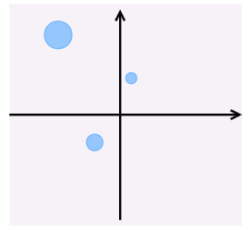
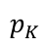
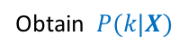
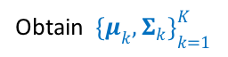
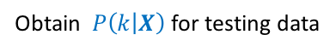
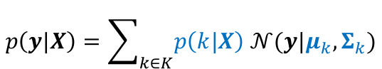
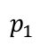
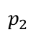
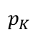
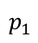
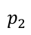
Methodology – GMM Modeling
$$p\left(y|X\right)=\sum_{k∈K}{p\left(k|X\right) 𝒩(y|μ_{k}, Σ_{k})}$$
Extract the possible emotions of texts
Obtain $P(k|X)$
Rate VA grouped by emotions
VA rating
rated
Locate each emotion at the likely position in VA space
training
Emo 1
$$p_{1}$$
Estimate Gaussian parameters
Classification
Emo 2
$$p_{2}$$
…
Obtain ${\{μ_{k}, Σ_{k}\}}_{k=1}^{K}$
Emo K
$$p_{K}$$
For testing data:
$$p_{1}$$
$$p_{2}$$
$$p_{K}$$
VA ratings
Emo 1
Emo 2
…
Emo K
Extract possible emotions of texts
Obtain $P\left(k | X\right)$ for testing data
Classification
Predict emotion distribution
testing
Evaluation
Modeling
Prediction
Notes:
分解這個圖！

Slide 19
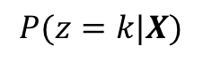
Methodology – Parameter Estimation
$$P(z=k|X)$$
Convolutional Neural Network (CNN)
word2vec
Emotion Classifier (EC)
emotion patterns
Random Forest (RF)
Multinomial Naïve Bayes (NB)
Bag-of-Word (BoW)
Latent Dirichlet Allocation (LDA)
(TF-IDF)
K-means
Notes:
TFIDF
word2vec
emotion patterns

Slide 20
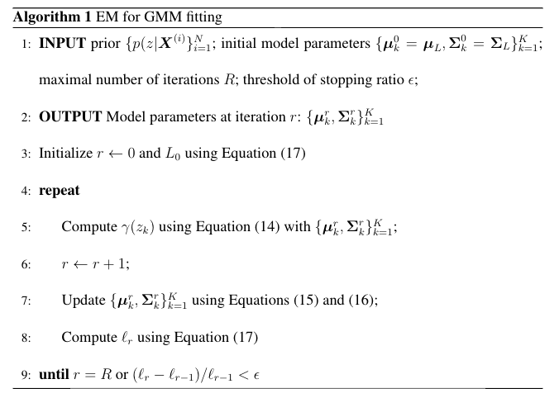
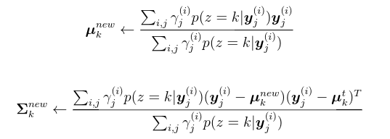
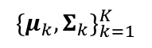
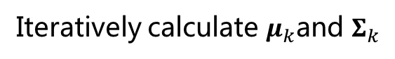
Methodology – Parameter Estimation
$${\{μ_{k}, Σ_{k}\}}_{k=1}^{K}$$
Expectation-Maximization (EM) Algorithm
Iteratively calculate $μ_{k}$and $Σ_{k}$
Notes:
分解這個圖！

Slide 21
Outline
Introduction
Related Work
Methodology
Experiment and Evaluation
Data Collection and Processing
Possible Emotions Extraction
Model Evaluation
Prediction Evaluation
Conclusion

Slide 22
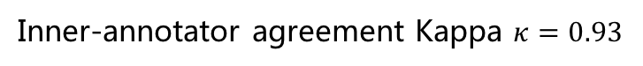
Methodology – Data Collection and Processing
Select typical social media texts
Released by Danel etc.
Each text has been rated by two professional annotators
Inner-annotator agreement Kappa $κ=0.93$
Selection Criteria
Difference of two annotators ratings on valence and arousal less than 2
Eight emotions
Joy
surprise
anticipation
trust
anger,
sadness
disgust,
fear
Daniel Preotiuc-Pietro, etc. Modelling valence and arousal in facebook posts. In Proceedings of NAACL-HLT, pages 9–15, 2016.
Notes:
We utilize a publicly released Facebook dataset as our research data. In this data, each text is rated by two professional annotators.
We first calculate the difference of two annotates ratings on valence and arousal. We only keep the text whose difference is less than 2.
Then we let annotators to label the text among eight emotion candidates.

Slide 23
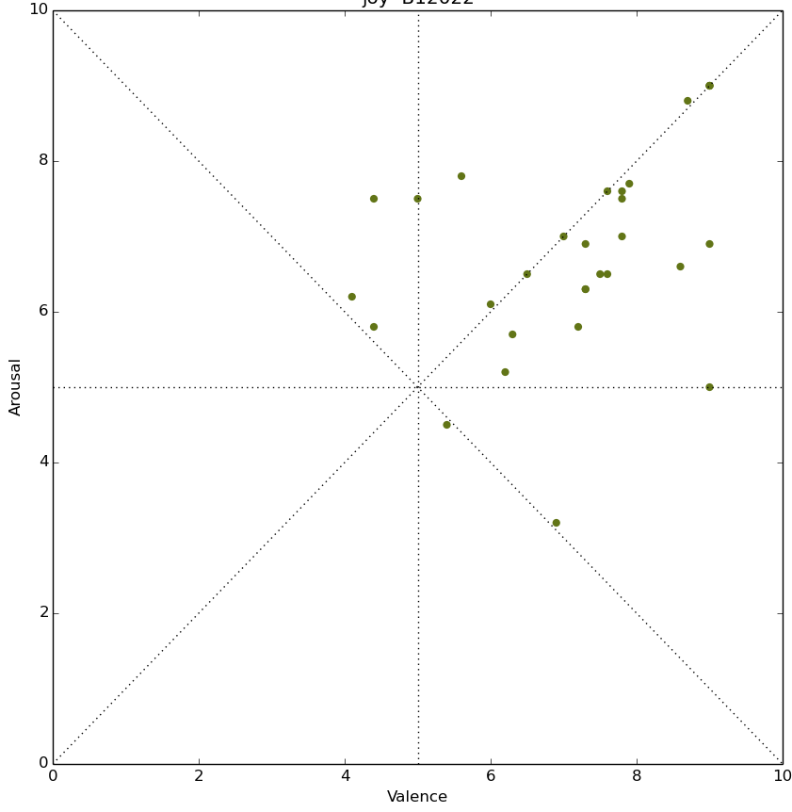
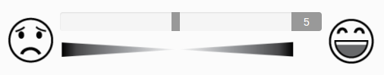
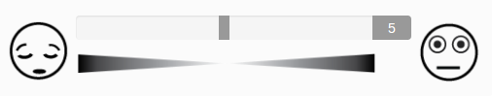
Experiment – Data Collection and Processing
Data collection is conducted on Amazon Mechanical Turk (AMT)
147 texts, each of which is rated by 30 different annotators
……
…
Range:
147 texts
30 annotators
Valence : 1~9
Arousal : 1~9
[Alberto Betella etc., 2016]
Notes:
In the end, 147 texts are selected to model EmoPredictor.
These data are then sent to Amazon Turk. Each text is rated with valence and arousal by 30 different annotators.
We also designed an interface to assist the annotators to rate.

Slide 24
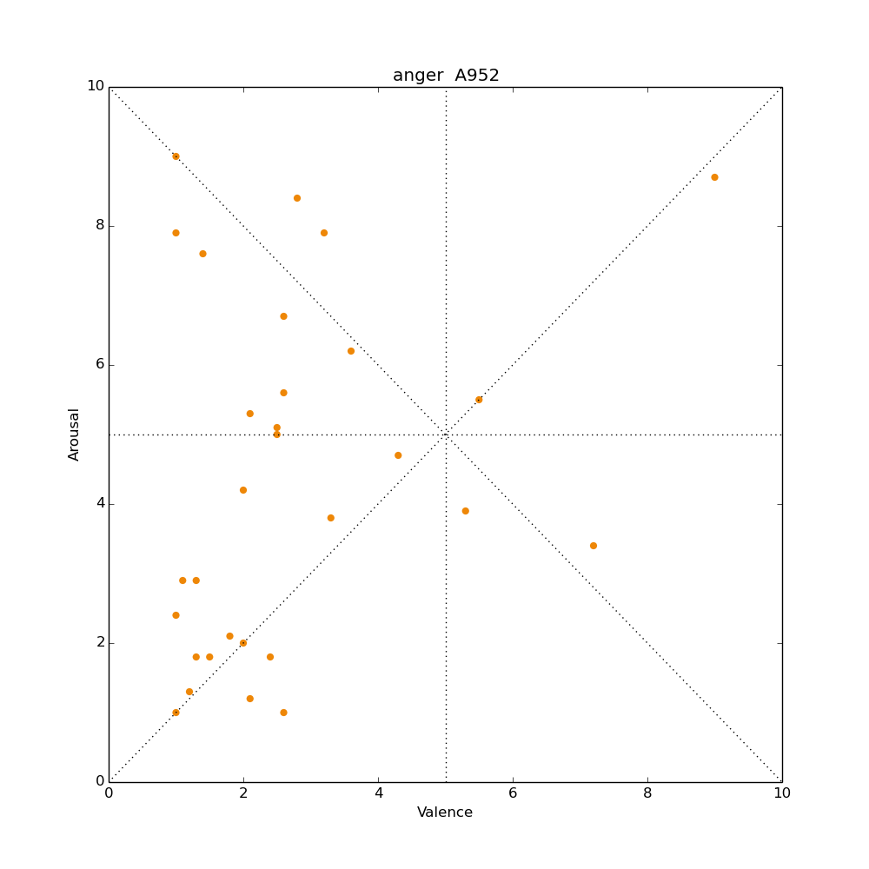
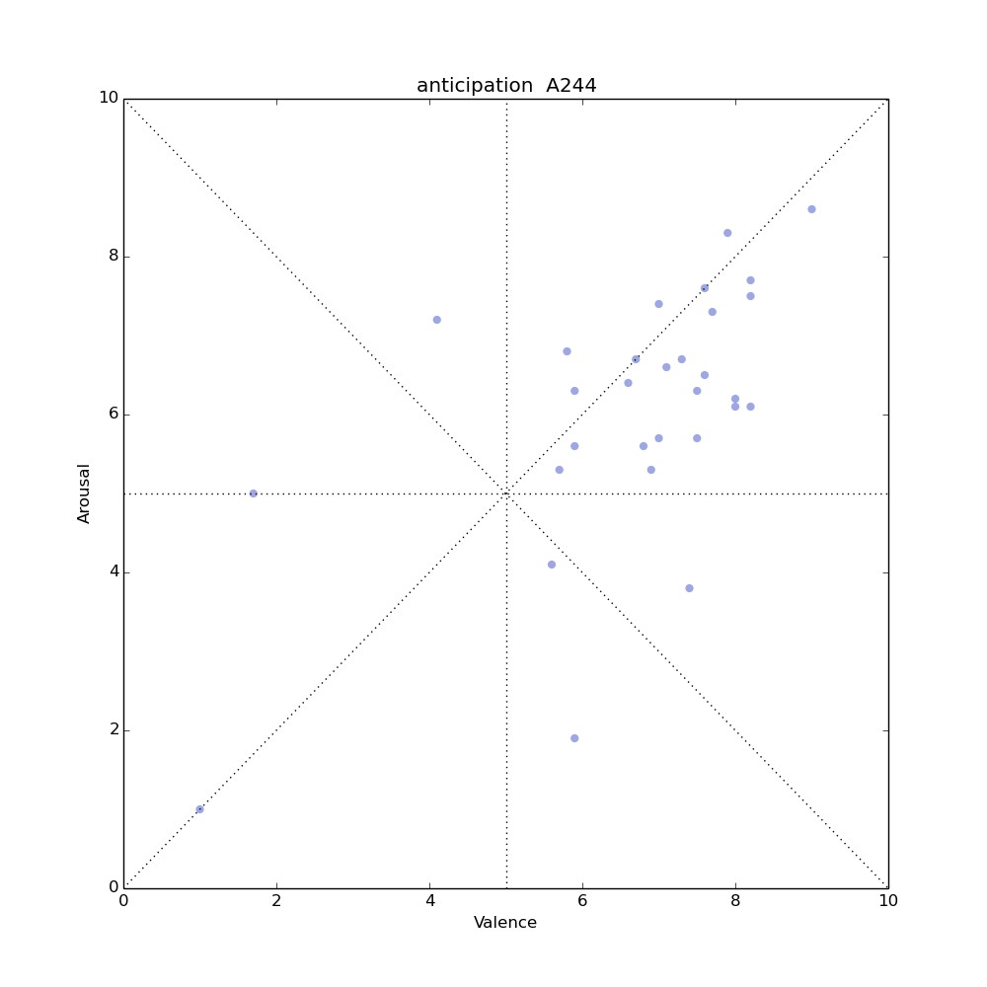








Experiment – Data Collection and Processing
Outlier Detection
$$\left({\overline{x}}_{v},{\overline{x}}_{a}\right)=(\frac{1}{n}\sum_{i=1}^{N}{v_{i}, }\frac{1}{n}\sum_{i=1}^{N}{a_{i}})$$
$$d_{i}=\sqrt{{\left(v_{i}−{\overline{x}}_{v}\right)}^{2}+{\left(a_{i}−{\overline{x}}_{a}\right)}^{2}}$$
A rating pair $\left(v_{i},a_{i}\right)$ is an outlier if:
$$σ_{d}=\sqrt{\frac{\sum_{i=1}^{N}{{\left(d_{i}−\overline{d}\right)}^{2}}}{n−1}}$$
$$d_{i}>2σ_{d}$$
$$\overline{d}= \frac{1}{n}\sum_{i=1}^{N}{d_{i}}$$
Notes:
once we get the VA ratings, we found there are some outliers.
We remove the outliers by the following equations.

Slide 25



Experiment – Possible Emotion Extraction
Texts classification and clustering for
$$p(k|Xt)$$
Type | Method | Features | |K|
Supervised | Emotion Classifier | Emotion Patterns | 8
 | Random Forest | BoW | 8
 | CNN | Word Embedding | 8
 | Naïve Byes | BoW | 8
Unsupervised | LDA | BoW | 8, 14
 | K-means | BoW | 8, 14
$$P\left(z=k | X\right)= \frac{e^{−sk}}{\sum_{k=1}^{K}{e^{−sk}}}$$
$$P\left(z=k | X_{t}\right)= \frac{1/d_{k}}{\sum_{k=1}^{K}{\frac{1}{dk}}}$$
Notes:
And then we utilize several emotion classifiers to extract the possible emotions.
We employ six emotion classification methods. Four of them are supervised and two are unsupervised. The emotion classifier is based on emotion patterns, which is a sequence of symbols, like words, punctuations and so on. Its output is eight emotions with eight scores. We use this calculation to convert the emotion score to emotion probability.
Similarly, K-means outputs the distance between the text and the its nearest cluster center. We use this calculation to convert the distance to emotion probability.

Slide 26
Experiment – GMM Model Results
fear
anger
anticipation
disgust
surprise
Generally, trust, anticipation, surprise, joy have high valence and high arousal
joy
trust
Sadness, anger, disgust and fear have low valence
sadness
Notes:
This is an example of the emotion locations in VA space. We can separate these eight emotions into positive emotions and negative emotions.
Trust, anticipation, surprise and joy have high valence and high arousal. We can treat them as positive emotions.
The remainder four emotions have low valence. They are negative emotions.
We can see that sadness is assumed in low arousal and the other three emotions in high arousal.

Slide 27

Experiment – GMM Model Results
Supervised modeling results
Anger
Surprise
Anger
Nearly all emotions are correctly classified in valence dimension
Surprise
Sadness
Sadness
Less accurate in classifying on arousal dim.
Anger
Anger
Different classifiers locate emotions in different positions
Surprise
Sadness
Sadness
Notes:
This is the model results of supervised classification.

Slide 28

Experiment – GMM Model Results
Unsupervised modeling results
Unsupervised methods poorly distinguish emotions
Largely overlapped
Increasing K may increase coverage
Notes:
This is the results of unsupervised methods.
As what the results show, the emotion distributions are different in different methods. To verify the performance of each emotion classifier, we develop a measurement.

Slide 29

Experiment – GMM Model Results
Average Emotion Distance (AEmoD)
The greater distance, the more distinguishable for components
$$AEmoD= \frac{1}{2}K(K−1)\sum_{i≠j}^{K}{∥μ_{i}−μ_{j}∥}$$
EC has the highest AEmoD
LDA8 has the lowest
Increasing K increases AEmoD
Notes:
We calculate the average emotion distance for each classifier according to this equation. The greater distance, the more distinguishable for the emotions. That is, the greater, the better. Because we hope the emotions separate from each other in VA space. Resutls shows that EC has the highest AEmoD and LDA8 has the lowest. We also found that increasing K can also increase the distance.

Slide 30
Experiment – GMM Prediction Results
Leave-one-out validation
fear
anger
Makes the number of testing data as the same as that of training data
anticipation
disgust
surprise
joy
trust
Generally, trust, anticipation, surprise, joy has high valence and high arousal
sadness
Sadness, anger, disgust and fear have low valence
Notes:
The previous results show how good the model is. Now let’s look at the performance of prediction results.
We run leave-one-out validation on the data so each text can be verified.
Recall the emotion location picture.

Slide 31






Experiment – GMM Prediction Results
Some Examples
EC
We hope:
Predicted emotion distribution covers as many as ratings
joy
sadness
anger
Position of predicted emotion close to direct observations
CNN
Two methods to evaluate the prediction
joy
sadness
anger
Notes:
Here are some examples of the prediction. For the same text, we can see that the predicted emotion distribution vary from each other by employing different methods.
We hope the predicted emotion distribution covers as many as ratings and the position is close to direct observations, that is the ratings that rated by annotators.
We use two methods to evaluate the performance of prediction.

Slide 32






Methodology – Evaluation
Prediction Evaluation
Kullback-Leibler divergence (KL divergence)
similarity between two probability distributions
$$g_{B}\sim 𝒩(μ_{B}, Σ_{B})$$
$$g_{A}\sim 𝒩(μ_{A}, Σ_{A})$$
$$D_{KL}(g_{A}|\left|g_{B}\right)=\sum_{i}{g_{A}\left(i\right)\ln{\frac{g_{A}(i)}{g_{B}(i)}}}$$
Predicted distr.
Direct Obn’s
$$g_{A}\sim 𝒩(μ_{A}, Σ_{A})$$
$$g_{B}\sim 𝒩(μ_{B}, Σ_{B})$$
GMM Model
GMM Prediction
Euclidean Distance (ED)
distance between predicted mean vectors and direct observations mean vectors
$$ED_{AB}=|\left|μ_{A}−μ_{B}\right||$$
Notes:
The first one is KL divergence. It measures the similarity between two probability distributions. g(A) is predicted emotion distribution and g(B) is direct observations. KL divergence is calculated by this equation.
The other measurement is Euclidean distance. It is the distance between predicted mean vectors and direct observations mean vectors.
KL divergence considers both means and covariance but ED only considers means.
Both of the two measurements, we hope the smaller, the better.

Slide 33
Experiment – GMM Prediction Results
Leave-one-out cross validation
Average KL divergence (AKL)
Average Euclidean Distance (AED)
Notes:
For leave-one-out cross validation, because each sample can be evaluated, we take average of KL and ED as the overall performance.
the results show that EC has the best performance on both AKL and AED.
It also shows that for K-means, increasing K will improve AKL. However, for LDA, it doesn’t.

Slide 34





Experiment – GMM Prediction Results
Turst
trust
EC
trust
RF
trust
CNN
trust
NB
Direct ob’ns
Notes:
Now let’s see the performance of each emotion.
This is the predicted emotion distribution for each text that belongs to trust.

Slide 35





Experiment – GMM Prediction Results
Anticipation
anticipation
EC
anticipation
RF
anticipation
CNN
anticipation
NB
Consistency direction
Direct ob’ns
Notes:
These are the results of anticipation.
Their direction are in consistency, following the diagnal.

Slide 36





Experiment – GMM Prediction Results
Surprise
surprise
EC
surprise
RF
surprise
CNN
surprise
NB
EC:
Higher valence and higher arousal
Direct ob’ns
Notes:
This is surprise. EC has higher valence and higher arousal compared to other methods. And it seems EC has an outlier.

Slide 37





Experiment – GMM Prediction Results
Joy
joy
EC
joy
RF
joy
CNN
joy
NB
Direct ob’ns
Notes:
This is joy.

Slide 38





Experiment – GMM Prediction Results
Sadness
sadness
EC
sadness
RF
sadness
CNN
sadness
NB
Sadness has big variance on arousal dimension
EC and RF reveal the low-arousal property
Direct ob’ns
Notes:
This is sadness. Sadness has variance on arousal dimension. EC and RF locate these texts in the left-down area.

Slide 39





Experiment – GMM Prediction Results
Anger
anger
EC
anger
RF
anger
CNN
anger
NB
Vertical direction
big variance on arousal and valence
But EC and RF are able to classify anger on valence
Notes:
This is anger. We can see that some predicted emotion distributions have vertical direction. Anger has big variance on both valence and arousal.
EC , RF and NB basically classify anger correctly on valence dimension.

Slide 40





Experiment – GMM Prediction Results
Disgust
disgust
EC
disgust
RF
disgust
CNN
disgust
NB
Ratings are similar to anger
EC: higher arousal
CNN: higher valence
Direct ob’ns
Notes:
This is disgust. The disgust ratings are similar to anger.

Slide 41





Experiment – GMM Prediction Results
Fear
fear
EC
fear
RF
fear
CNN
fear
NB
Direct ob’ns
Notes:
This is fear

Slide 42
Experiment – GMM Prediction Results
Though the variance of ratings is high, EmoPredictor can still catch the expected position
Joy, surprise, anticipation and trust are high valence
Disgust is low valence and high arousal (anger cover high arousal partly)
Sadness is low valence and low arousal
Most of the predictions have expected direction
What roles do the classifiers play?
Does accuracy of classifier matter?

Slide 43
Experiment – GMM Prediction Results
Classification performance (overall)
Prediction performance (overall)
Naïve Bayes:
higher classification performance, lower prediction performance
If a text is misclassified, it still could be correctly predicted by combining ratings distribution and emotion probability

Slide 44


Experiment – GMM Prediction Results
VA Rating Behaviors
influenced by the rating interface
influenced by idiographic personalities
People have polar feelings on anger
Extroversion
Agreeableness

Slide 45
Conclusion
A parametric model is proposed for quantifiably analyze emotions
Integrate a deterministic emotion classifier into a parametric model
Not only one emotion is provided but also the potential emotions and trend with strength are available
Flexible and Scalable
Emotion Probability can be replaced by any classifiers
|K| can be increased
Balances misclassification problem and divergence ratings problem
Reduces the influence of misclassification and divergence ratings at the same time
VA Rating Behaviors
For positive emotions, people tend to rate higher valence in combination with higher arousal
For negative emotions, ratings are in variance on arousal dimension by individual

Slide 46
Thank you.

